Slide 1


Scene Segmentation using MovieScenes Dataset Eluvio Challenge
Sankalp Singh
ssingh56@syr.edu
201-417-5997

Slide 2
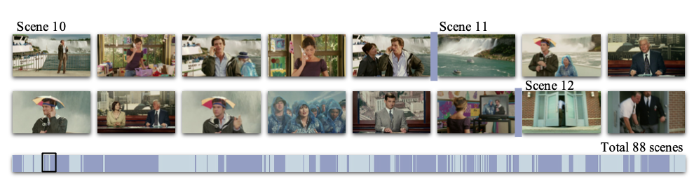
Introduction
In this challenge, our task is to predict the scene segmentation for each movie given features for each shot
One scene contains a series of consecutive shots. To define the problem, we first carry out shot detection for movies and group shots afterward to form scenes, where the scene boundary detection could be regarded as a binary classification problem on shot boundaries

Slide 3
Dataset Description
Dataset includes 64 .pkl files corresponding to 64 movies
Dataset features:
place
cast
action
audio
shot_end_frame
scene_transition_boundary_ground_truth (target feature)
scene_transition_boundary_prediction
imdb_id

Slide 4
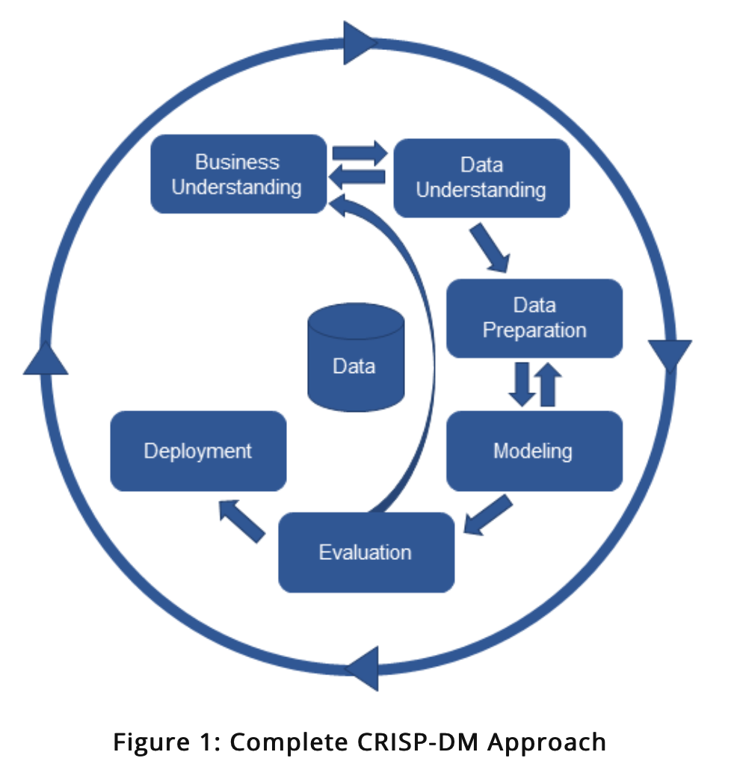
Approach
We have used the CRISP-DM approach here for our research work which consists of following steps:
Business & Data understanding
Data cleaning and pre-processing
Modeling
Evaluation
Deployment
This is a binary classification problem where for each input video, our models would predict the binary output ground truth labels – 0 for False and 1 for True stating that a shot boundary represents a scene boundary
Due to lack of computing resources, we have trained our machine learning models on 10 pkl for 10 movies instead of all the 64 movies

Slide 5
System Architecture
Business & Data understanding
Data Pre-Processing & Exploratory Data Analysis
Data Transformations to convert tensors to dataframe columns
Evaluation of results
Machine Learning models and algorithms
Feature engineering: Introducing lags for each semantic features and Using Under sampling technique to handle imbalanced dataset

Slide 6
Data Preprocessing & Transformations
We have extracted the 2048 feature vectors for place & 512 features vectors for cast, action and audio into a list and have converted that list into separate dataframes with 2048 columns for place and 512 columns for cast, action and audio respectively
We have also extracted the tensor features for shot_end_frame, imdb_id, scene_transition_boundary_prediction and scene_transition_boundary_ground_truth into lists and converted the lists into separate dataframes
We have appended the first element of scene_transition_boundary_prediction and scene_transition_boundary_ground_truth with a "NaN" value because the length of ground truth and boundary prediction tensors is one less than the length of all the other tensor features
Finally, we have concatenated all the data frames into a single data frame that consists of all the shot features predictors for 10 movies and the target feature - ground truth

Slide 7
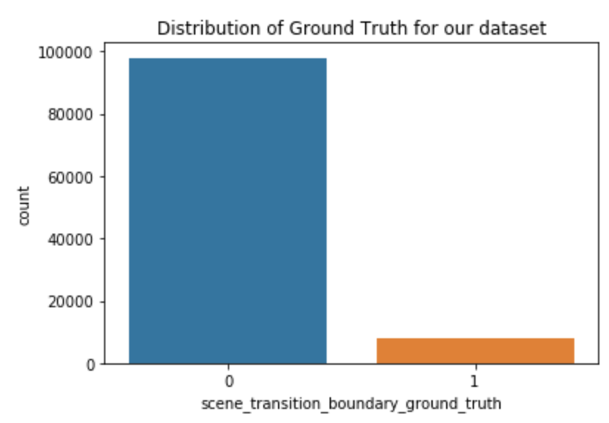
Exploratory Data Analysis
Distribution of ground truth labels for the dataset

Slide 8
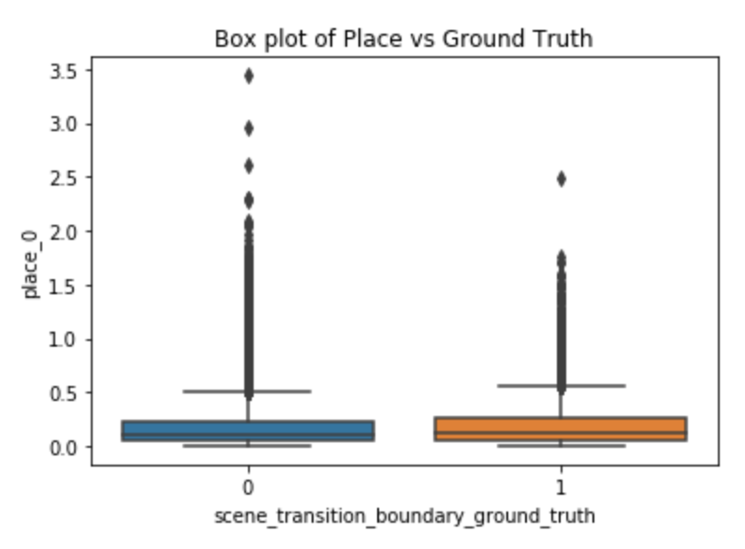
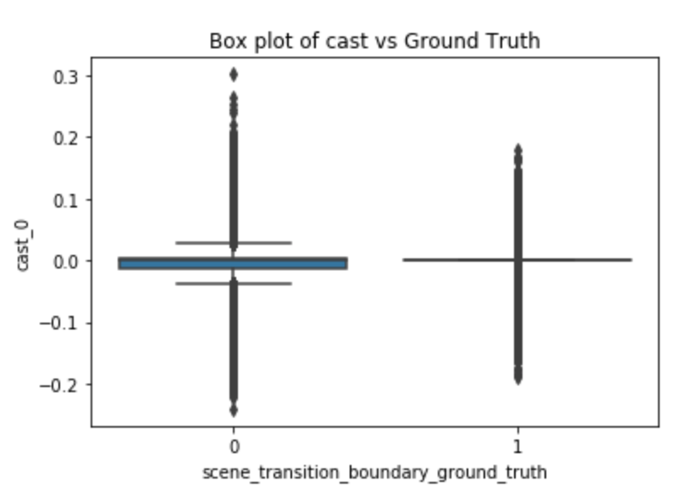
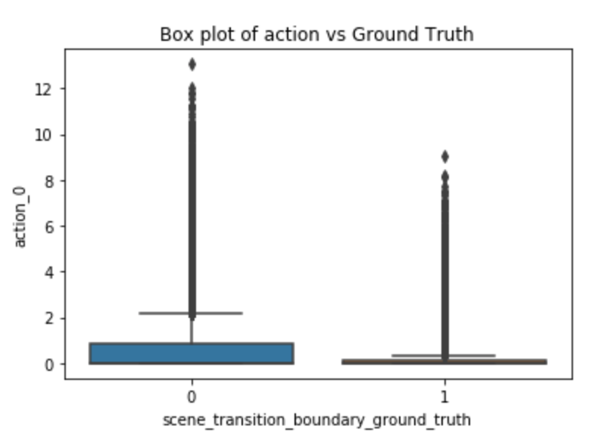
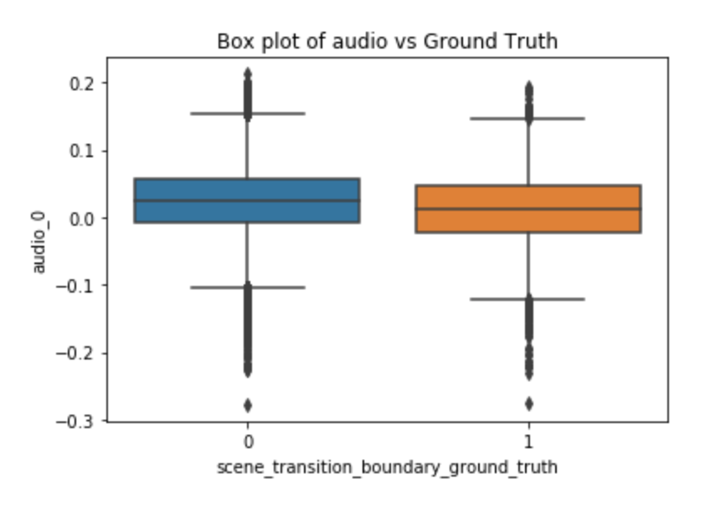
EDA
Box plots for 4 semantic features – place, cast, action, audio

Slide 9
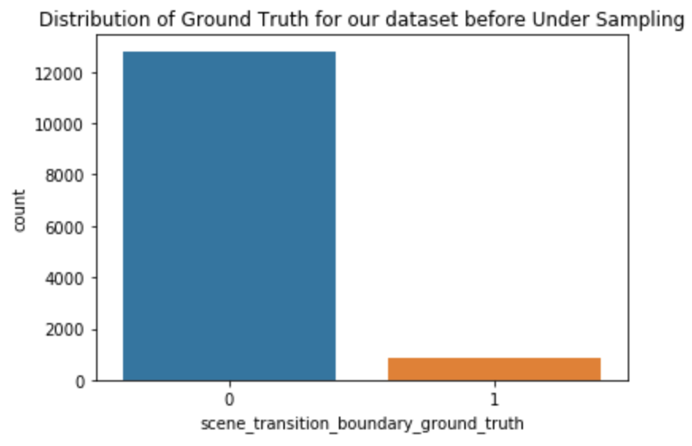
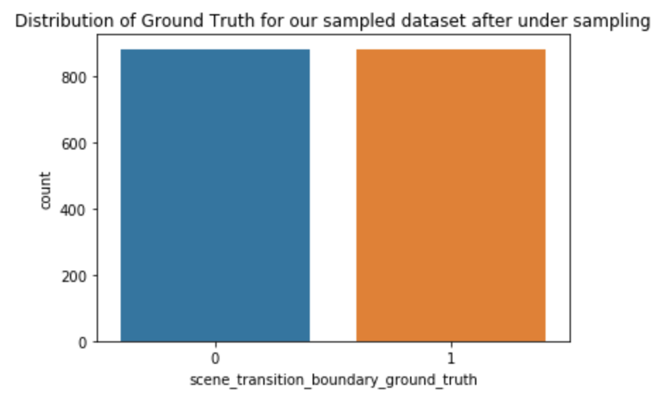
Feature Engineering: Under Sampling Technique
Our dataset is highly imbalanced with respect to the target feature - ground truth
To handle this imbalanced dataset problem, we have used the undersampling technique
We have brought down the count of overrepresented classes to match the count of underrepresented classes using a random sample which has been extracted from the original dataset

Slide 10
Feature Engineering: Introducing Lags
To handle the sequential shot features, we have introduced new features with a single lag for all the 4 semantic features
We have introduced a new column for each of the 2048 place columns and 512 cast, action and audio columns

Slide 11
Modeling Approaches
1) We have implemented the models without using "scene_transition_boundary_prediction" as a predictor – without lags
2) We have implemented the models using "scene_transition_boundary_prediction" as a predictor without lags
3) We have implemented the models using "scene_transition_boundary_prediction" as a predictor with lags
4) We have implemented the models without using "scene_transition_boundary_prediction" as a predictor – with lags

Slide 12
Evaluation & Results – Model Approach 1
Models without boundary prediction feature and without lags | Recall | Accuracy | Precision | F1 | AUC
Logistic Regression | 67 | 68 | 71 | 69 | 74.9
Random Forest | 65 | 65 | 63 | 64 | 71.9
Artificial Neural Network | 72 | 69 | 67 | 70 | 72.8
Gradient Boosting | 67 | 68 | 72 | 69 | 72.8
Linear SVM | 68 | 70 | 76 | 72 | -

Slide 13
Evaluation & Results – Model Approach 2
Models with boundary prediction feature and without lags | Recall | Accuracy | Precision | F1 | AUC
Logistic Regression | 80 | 82 | 84 | 82 | 82
Random Forest | 55 | 57 | 73 | 63 | 61
Artificial Neural Network | 77 | 71 | 69 | 73 | 77
Linear SVM | 73 | 75 | 80 | 76 | -

Slide 14
Evaluation & Results – Model Approach 3
Models with boundary prediction feature and with lag | Recall | Accuracy | Precision | F1 | AUC
Logistic Regression | 89 | 89 | 90 | 89 | 95.5
Random Forest | 77 | 77 | 79 | 78 | 85.7
Artificial Neural Network | 50 | 50 | 50 | 50 | 50
Linear SVM | 75 | 75 | 75 | 75 | -

Slide 15
Evaluation & Results – Model Approach 4
Models without boundary prediction feature and with lag | Recall | Accuracy | Precision | F1 | AUC
Logistic Regression | 75 | 76 | 78 | 76 | 83.5
Random Forest | 72 | 72 | 73 | 72 | 79.4
Artificial Neural Network | 50 | 50 | 50 | 50 | 50
Linear SVM | 72 | 71 | 70 | 71 | -

Slide 16
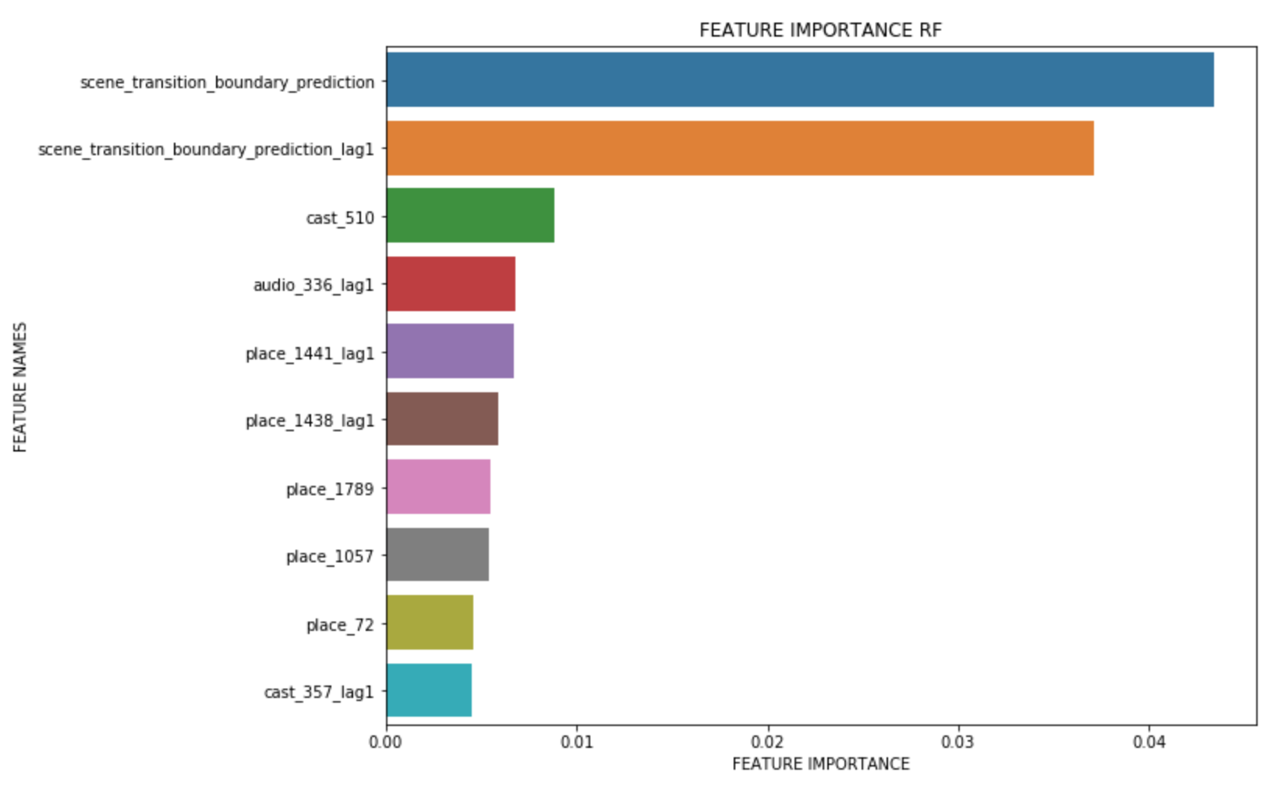
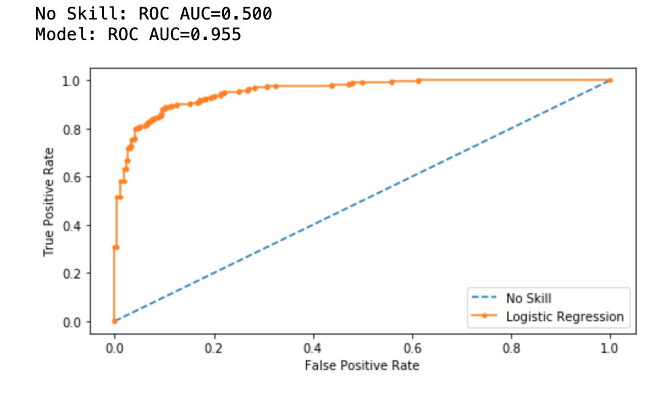
Feature Importance Plot and AUC-ROC Plot for Best Model

Slide 17
Evaluation Metrics
We have used the F1 score as one of the evaluation metrics for evaluating the performance of our machine learning models
Other evaluation metrics include:
Mean Average Precision (mAP) -- AP measures the quality of scene transition predictions in a movie. Specifically, it is the mean of precisions achieved at each threshold, weighted by the increase in recall. Then mAP is the mean of all AP scores
Mean Maximum IoU (mean Miou) -- Miou measures how well the predicted scenes and the ground-truth scenes overlap in a movie. Then we take the mean of all Miou scores as the final score

Slide 18
Conclusion
We have implemented several machine learning models for the 4 approaches
Logistic Regression model seems to outperform all the other models in 3 out 4 approaches that we have implemented
Introducing lags in the semantic features seems to be helpful in predicting the ground truths for boundary transition
Using the feature – scene_transition_boundary_prediction – in the models as one of the predictors also seems to be useful in predicting the ground truth labels
With more computing resources, we can train the models for all the movies

Slide 19
References
Baraldi, Lorenzo, et al. “A Deep Siamese Network for Scene Detection in Broadcast Videos.” arXiv.org, 2015, https://arxiv.org/abs/1510.08893.
Rao, Anyi, et al. “A Local-to-Global Approach to Multi-modal Movie Scene Segmentation.” arXiv.org, 2020, https://arxiv.org/abs/2004.02678.

